Slide 1

Team ID: 14946
Team Name: Binary Brainss
No. of Members: 5
Team Leader Name: Shreya Hardas
Problem Statement ID: DH1039

Slide 2
Details of all Team Members
SN | Team Member Name | Role | College Passing Year
1 | Shreya Hardas | Team Leader | 2022
2 | Shravani Chavan | Team Member | 2022
3 | Archana Ramalingam | Team Member | 2022
4 | Krutika Kulkarni | Team Member | 2022
5 | Bhakti Chindhe | Team Member | 2022
6
7

Slide 3
Idea Description
Our solution consists of a Web-based cross-platform app that circumvents
the existing blockers present in the EPFO website and makes
PF claims seamless.
It makes it convenient for users with limited knowledge of regional
languages, incapability of using smartphones and unawareness of rules and procedures to fill forms to file claims with ease with the added advantage of chatbots, OCR

Slide 4
Innovative Idea Solution
Currently, labourers/employees seek advice from agents due to lack of knowledge about provident funds and claims and unaware about the rules and procedure to be followed while filing a claim.
• Thus, create a user-friendly mobile application for the sole purpose of filing claims.
• Providing login page for employees – registration with username, password, email ID and mobile number • Verify users based on Aadhar/PAN details
• User panel for filing claim of PF
• Verification of employee details and upload of necessary documents
• Filing for claim and receive notifications for timely updates
• Provide voice assistance and chatbot functionality for hassle free usage.
• Provide step by step tutorial for easy use

Slide 5
Reference Architecture / Solution Architecture
Solution Architecture:
Our solution focuses on creating a web application that improves the experience of the end user while filing for claims. The UI is extremely interactive to help people understand the workflow of the app and subsequently file for claims easily.
A chatbot feature is also present to solve claim related doubts, it also provides tutorial steps for any new user who has no knowledge on filing of claims.
The app also provides OCR for extracting vital information related Aadhar etc.

Slide 6
Technology Stack
MongoDB
ExpressJS
NodeJS
ReactJS
Html

Slide 7
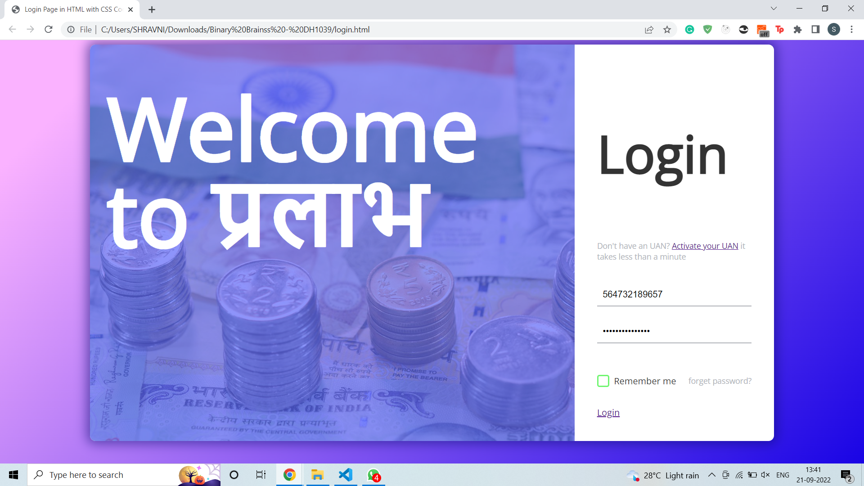
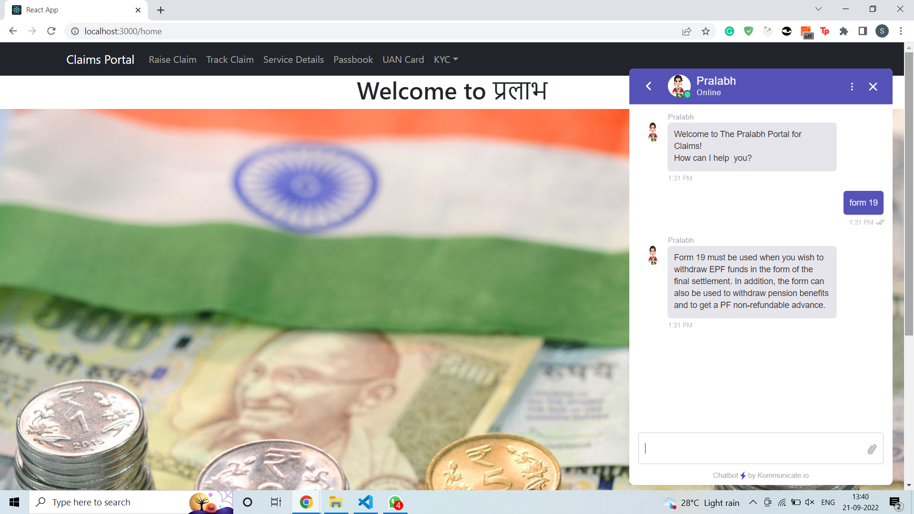
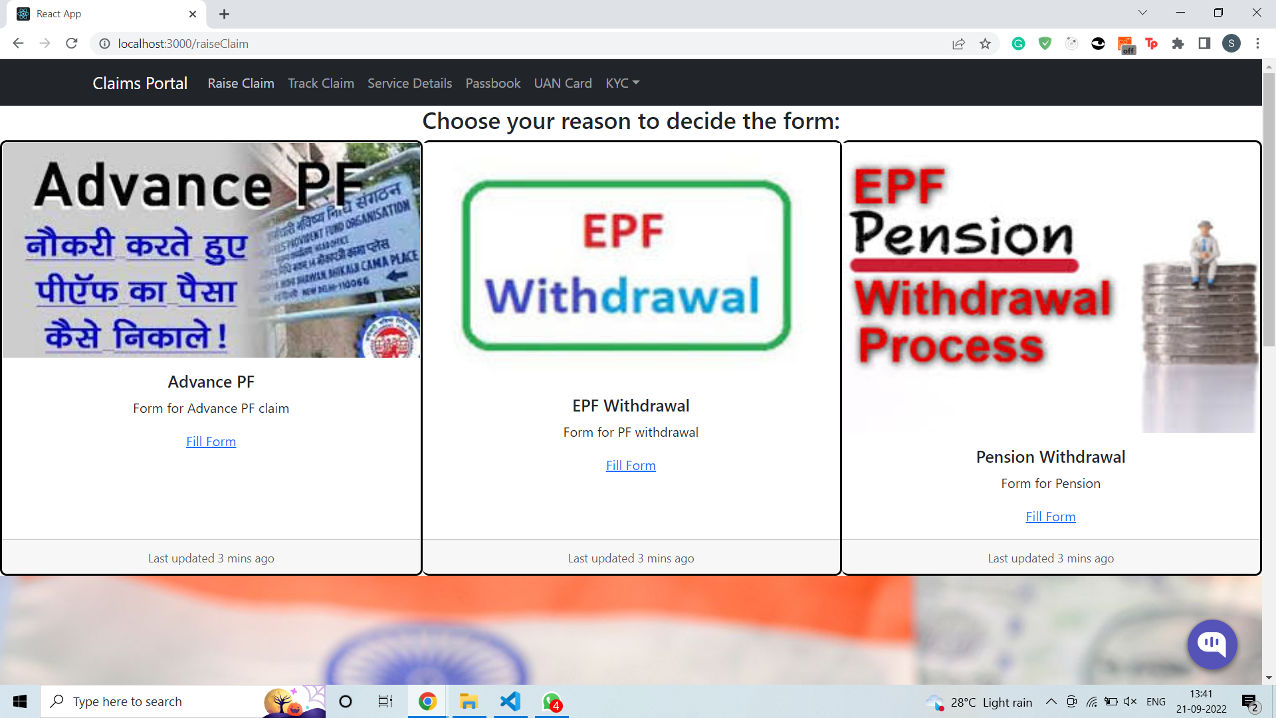
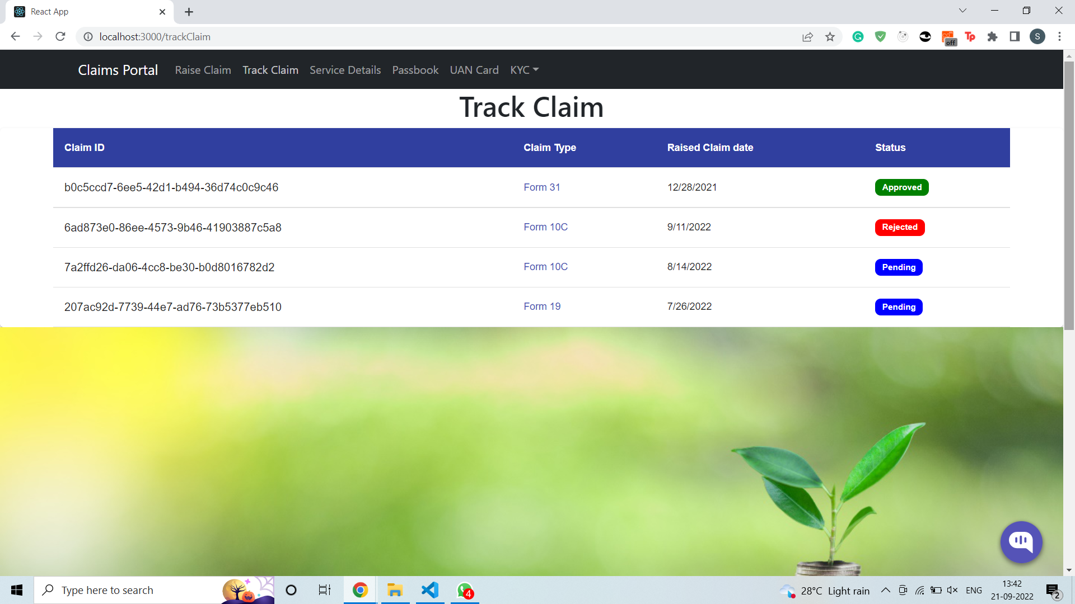
Images / Screenshots of the working prototype

Slide 8
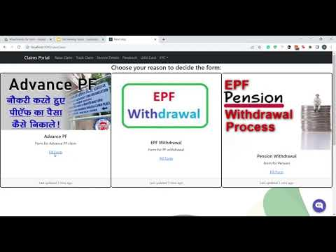
Video of Working Prototype

Slide 9
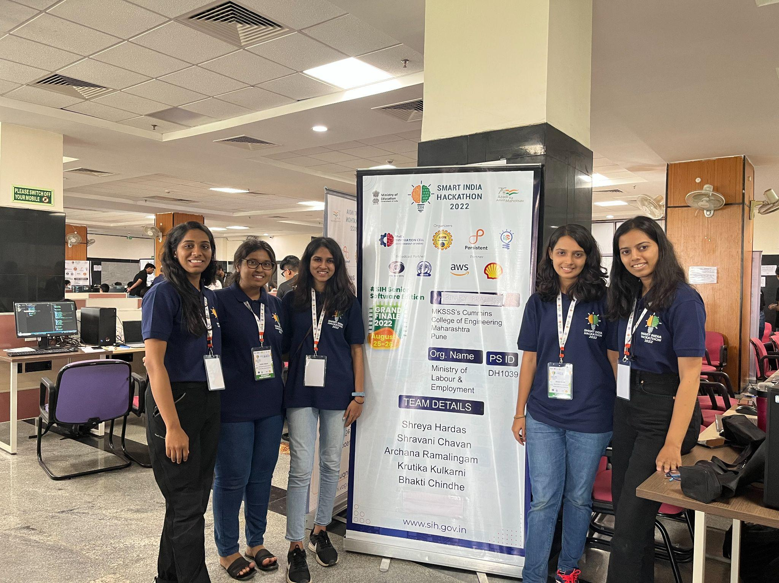
Group Picture of all Participants with Developed Prototype

